Slide 1
Electronic safe
Team.1

Slide 2
Introduction

Slide 3
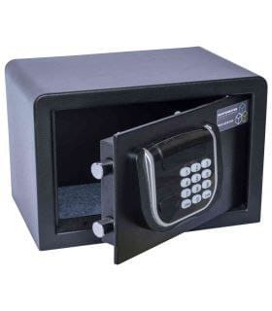
An electronic safe is a certain type of safe with an electronic lock.
This can be a burglar-resistant safe, a fire-resistant safe or a double-certified safe that offers protection against both.
The electronic lock blocks and unlocks the locking mechanism based on a self-selected pin code that is entered.

Slide 4
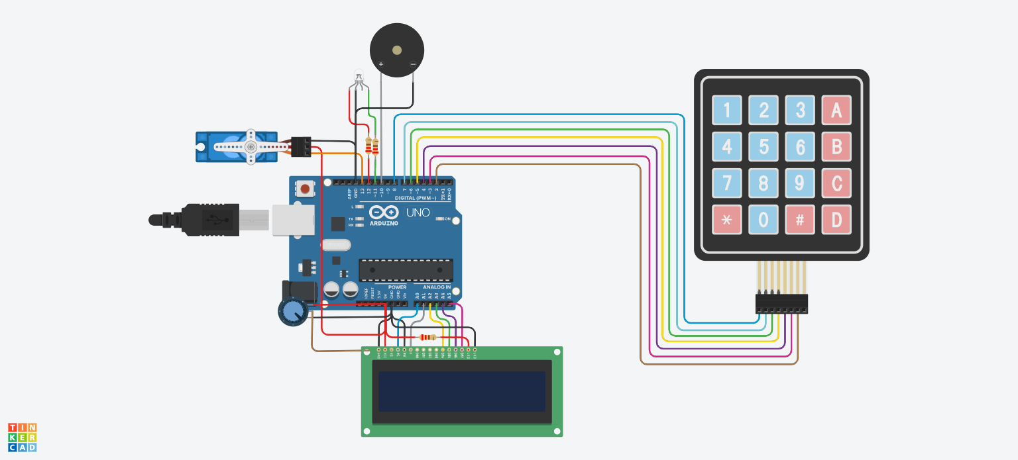

Slide 5
CONTENTS
01.
Jumpers
Resistor
RGB
Buzzer
Potentiometer
Arduino
LCD
Keypad
Servo Motor
components

Slide 6
CONTENTS
01.
Jumpers
Resistor
RGB
Buzzer
Potentiometer
Arduino
LCD
Keypad
Servo Motor
components

Slide 7
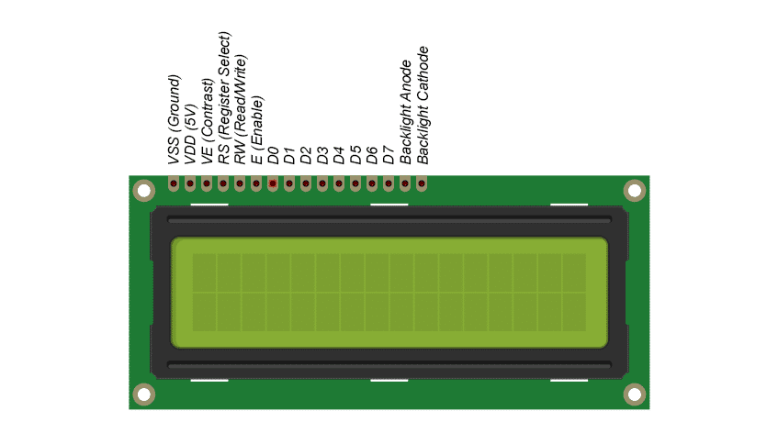
LCD(Liquid Crystal Display):
The LCD is a screen that is used to display text, a number, or a symbol.

Slide 8
The LCD consists of the display screen, which contains two rows and 16 columns, and consists of 16 pins, as follows:
*VSS(Ground): Connect to the ground of the Arduino.
*VDD(VCC): connected to 5V pin for feeding the (HD 44870) LCD controller.
*Vo: we connect it with a potentiometer to control the brightness.
*RS(Register Selector):has two values :
1-low for COMMON REGISTER which is responsible for the commands that we give to the LCD.
2-High for DATA REGISTER that gives the data we entered.
So we connect it with digital pins.
*RW(Read Write): Most of the time we use it in writing ,so we connect it in the ground.
*E(Enable): Enable LCD to work or not.
*D0----→D7: For screen programming, we mostly do not use the eight pins because it will give a big load on the Arduino, so we mostly use four pins only.
*A (Anode): we connect it to 5v source.
*K(Cathod): we connect it to the ground.

Slide 9
And To program the LCD, you must first include its own library
#include <LiquidCrystal.h>
And Defining LCD pins
LiquidCrystal lcd(--6 pins we connect--);
These are the most used functions:
lcd.setCursor(0,0):used for setting the position of pointer.
lcd.begin():for beginning text.
lcd.print(“TEXT”):for printing the text we need.
lcd.scrollDisplayLeft():for Shifting the text to left.
lcd.clear():for clearing the text in lcd.

Slide 10
CONTENTS
01.
Jumpers
Resistor
RGB
Buzzer
Potentiometer
Arduino
LCD
Keypad
Servo Motor
components

Slide 11
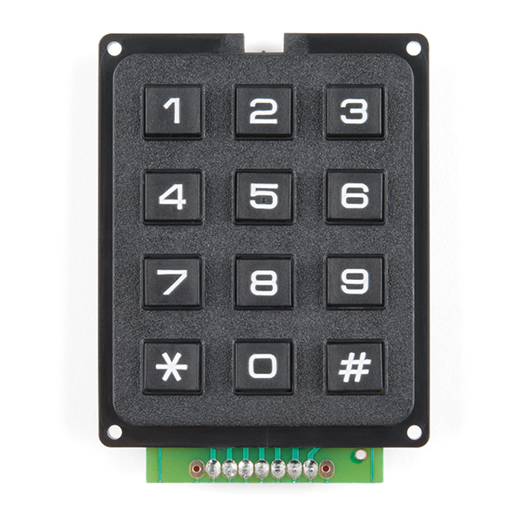
A keypad is an electronic input device that consists of a grid of buttons or keys.
Each key is assigned a specific function, such as a letter or number, or a command or action.
Keypads can be found in many electronic devices, including calculators, mobile phones, security systems, and electronic safes.
A keypad is a popular method of securing an
electronic safe, and it offers
several benefits over other
locking mechanisms.

Slide 12
Here are some of the benefits and uses of a keypad in an electronic safe:
1- Convenience: Keypads are easy to use and do not require a physical key. This means you do not have to carry around a key that could be lost or stolen. Instead, you only need to remember a unique code to access your safe.
2- Security: Keypads offer high levels of security, as the code required to open the safe can be personalized and difficult to guess. Additionally, electronic safes with keypads often have built-in security features, such as time-delayed access or lockout periods after incorrect code attempts.
3- Speed: Keypads allow for quick access to the contents of the safe, as the user can simply input their code to unlock it.
4- Multiple Users: Keypads can be programmed to allow multiple users to access the safe. This is particularly useful in a business or family setting where multiple people need access to the contents of the safe.
5- Audit Trail: Some electronic safes with keypads can track who has accessed the safe and when. This provides an audit trail and can help to deter theft or unauthorized access.
Overall, the keypad is a convenient and secure way to lock and unlock an electronic safe. It offers fast and easy access while ensuring the contents of the safe remain secure.

Slide 13
To write code for a keypad, you first need to include the appropriate library for your microcontroller or development board
“ #include <Keypad.h>”.
Then, you need to define the rows and columns of your keypad using the const command ,and create an array of characters to represent the keys on your keypad.
const int ROWS = 4; //Number of rows on the keypad
const int COLS = 3; //Number of columns on the keypad
char keys[ROWS][COLS] = {
{'1','2','3'},
{'4','5','6'},
{'7','8','9'},
{'*','0','#'}
};

Slide 14
Next, you need to assign the row and column pins of your keypad to Arduino pins on your board.
byte rowPins[ROWS] = {Arduino pins}; //connect to the row pinouts of the keypad
byte colPins[COLS] = { Arduino pins }; //connect to the column pinouts of the keypad
Keypad keypad = Keypad(makeKeymap(keys), rowPins, colPins, ROWS, COLS);
Finally, you can use the Keypad library functions to scan the keypad and detect key presses. This typically involves creating a Keypad object and calling its getKey() function to retrieve the value of the key that was pressed. You can then use this value to trigger specific actions or functions in your code.
char key = keypad.getKey(); //get the pressed key
if (key) { //if a key is pressed
Serial.println(key); //print the key value
}
Overall, writing code for a keypad involves a few basic steps: including the library, defining the keypad layout and pins, and using Keypad functions to read key presses. With these tools, you can create custom keypad applications for a variety of electronic projects.

Slide 15
CONTENTS
01.
Jumpers
Resistor
RGB
Buzzer
Potentiometer
Arduino
LCD
Keypad
Servo Motor
components

Slide 16
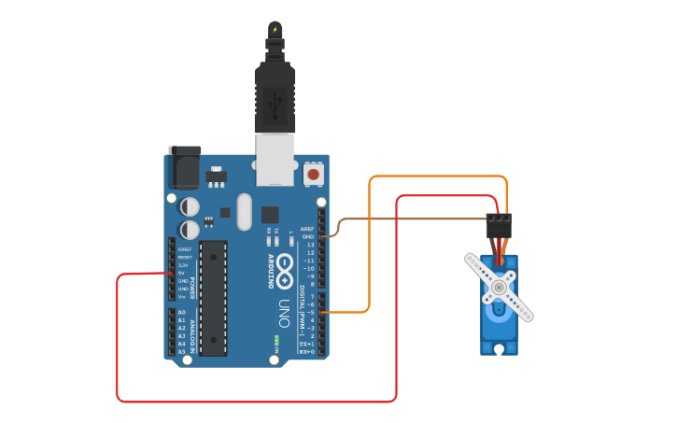
Servo Motor
Servos have integrated gears and a shift that can be precisely controlled standard servos allow the shaft to be positioned at various angle, usually between 0 and 180 degrees.
It has many uses, such as elevators, escalators, and robotics.
Have three wires: power , ground and signal.
The power wire is typically red, and should be connected to the 5v pin on the arduino board
The ground wire is typically black or brown should be connected to a ground pin on the arduino board
The signal pin is typically yellow, orange or white and should be connected to a digidal pin on the arduino board

Slide 17
You must first include library
#include <Servo.h>
Create servo object to control a servo
Servo objectName;
Attaches the servo on pin (13) to the servo object
objectName.attach(13);
objectName.write(value);
Writes a value to the servo, controlling the shaft accordingly. On a standard servo, this will set the angle of the shaft (in degrees), moving the shaft to that orientation
Value
0→ Moving the shaft to vertical orientation(Default)
90→ Moving the shaft to horizontal orientation

Slide 18
CONTENTS
02.
code

Slide 19
Project Link
Click here

Slide 20

1

Slide 21
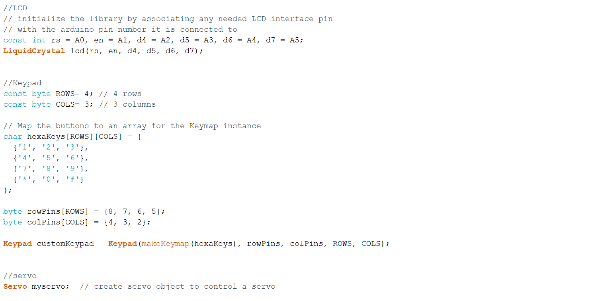
2

Slide 22
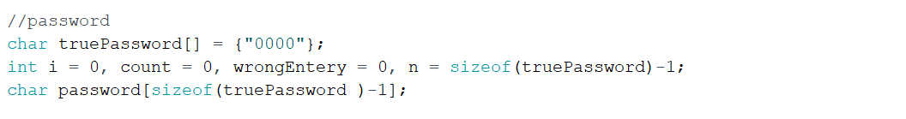
3

Slide 23
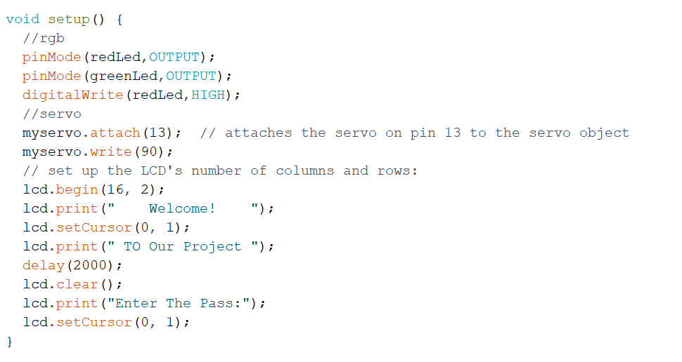
4

Slide 24
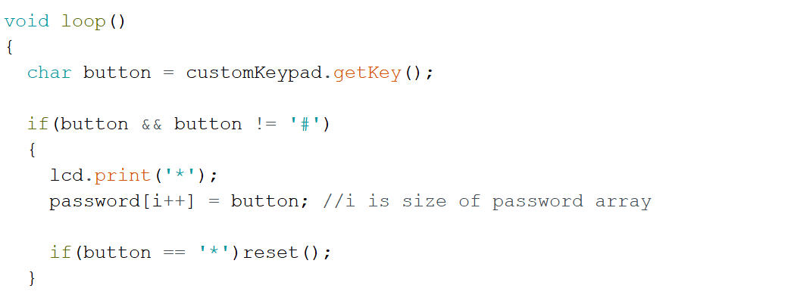
5

Slide 25

6

Slide 26
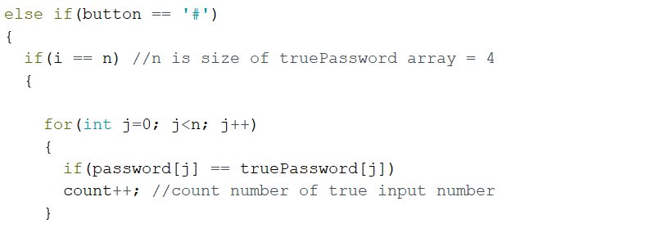
7

Slide 27
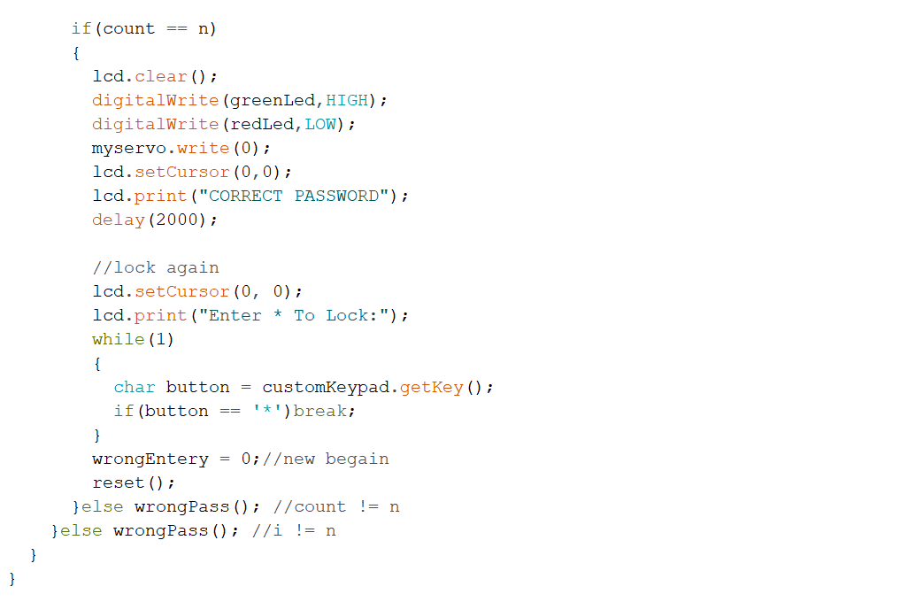
8

Slide 28
9

Slide 29

10

Slide 30
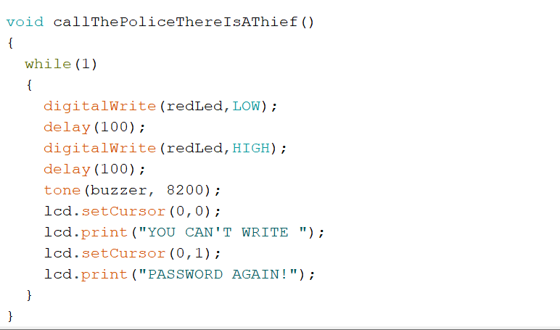
11

Slide 31
Thanks !
Any Question?!!

